Slide 1


Slide 2

Major Project-I (01CE0716)
Review 2 (23/08/2025)
Handwritten Digit Recognition Using CNN
Team ID: 7CE_141
Team Member 1: DHRUV KHANT (92310103075) (7-TC4)
Team Member 2: SHUBHAM DILLIP (92310103062) (7- TC1)
Guided By
Internal Guide Name: Prof. Wanglen Soram
Department of Computer Engineering, Faculty of Engineering & Technology

Slide 3
INTRODUCTION
Handwritten digit recognition is a fundamental computer vision problem. It involves training a machine learning model to classify digit images (0-9) based on pixel data. The MNIST dataset is a widely used benchmark for this task, containing 70,000 labeled grayscale images.
In Simple Terms:
Input: Image of a digit
Output: Predicted digit label (0 to 9)
ABSTRACT
The MNIST dataset contains 70,000 grayscale images of handwritten digits (28x28 pixels).
CNNs mimic the human visual system and are widely used in image classification tasks.
This beginner-friendly project utilizes a Convolutional Neural Network (CNN) to recognize digits
from the MNIST dataset. This project focuses on recognizing handwritten digits from the MNIST dataset using various deep learning models. The models include Basic CNN, LeNet-5, ResNet, LSTM/RNN, Deeper CNN, and CNN with Dropout Regularization. Each model is trained and evaluated to compare performance in terms of accuracy and generalization. Results show that deeper architectures and regularization improve recognition accuracy, paving the way for robust digit classification systems.

Slide 4
Why Digit Recognition?
Automation of data entry
Postal code recognition
Bank check processing
Foundational task for learning image classification
Specially to recognise doctor’s handwritting which provides prescription to their patients
Problem Statement
Problem: Build a machine learning model that accurately classifies handwritten digits.
Why? Manual digit processing is slow and error-prone. Automating this improves efficiency and reduces human error.
Goal: Train multiple deep learning architectures and compare their performance on MNIST dataset.

Slide 5
Literature Review / Survey
Author & Paper Title | Year | Dataset Used | Methodology | Model / Algorithm | Accuracy / EER | Paper Limitations
Yang et al – Robust audio deepfake detection via multi-view feature [1] | 2024 | ASV2019 + In‑the‑Wild | Multi-view feature fusion | Learning-based fusion model | EER 24.27 % on wild | High false positives; dataset small and lacks diversity; poor performance on deepfake speech.
Pham et al – Spectrogram-based ensemble DL models [2] | 2024 | ASVspoof 2019 | STFT/CQT/WT + transfer learning + embeddings | Ensemble CNN, RNN, MLPs | EER 0.03% | Performance drops with limited training; struggles with gradient modifications; requires better regrouping.
Jetti et al – Deepfake Audio Detection Using ML Algorithms [3] | 2023 | Fake‑or‑Real dataset | MFCC features | SVM, GB, VGG‑16 | Max accuracy 93 % | Limitations not addressed in the paper.
L. Li et al. – Voice Deepfake Detection Using HuBERT– [4] | 2023 | ASVspoof 2021 LA | Self‑supervised HuBERT fine‑tuning + α‑FMS + RawNet2 | HuBERT + modified RawNet2 | EER 2.89% | FMS scaling vector restricts both addition/multiplication; optimization difficult.
Xue et al – Audio Deepfake Detection Based on F0 & Spectrogram [5] | 2022 | ASVspoof 2019 LA | F0 + real/imag spectrogram features | CNN fusion | EER 0.43 % | Limited dataset size; weak against high-quality deepfakes; potential vulnerabilities; efficiency issues.

Slide 6
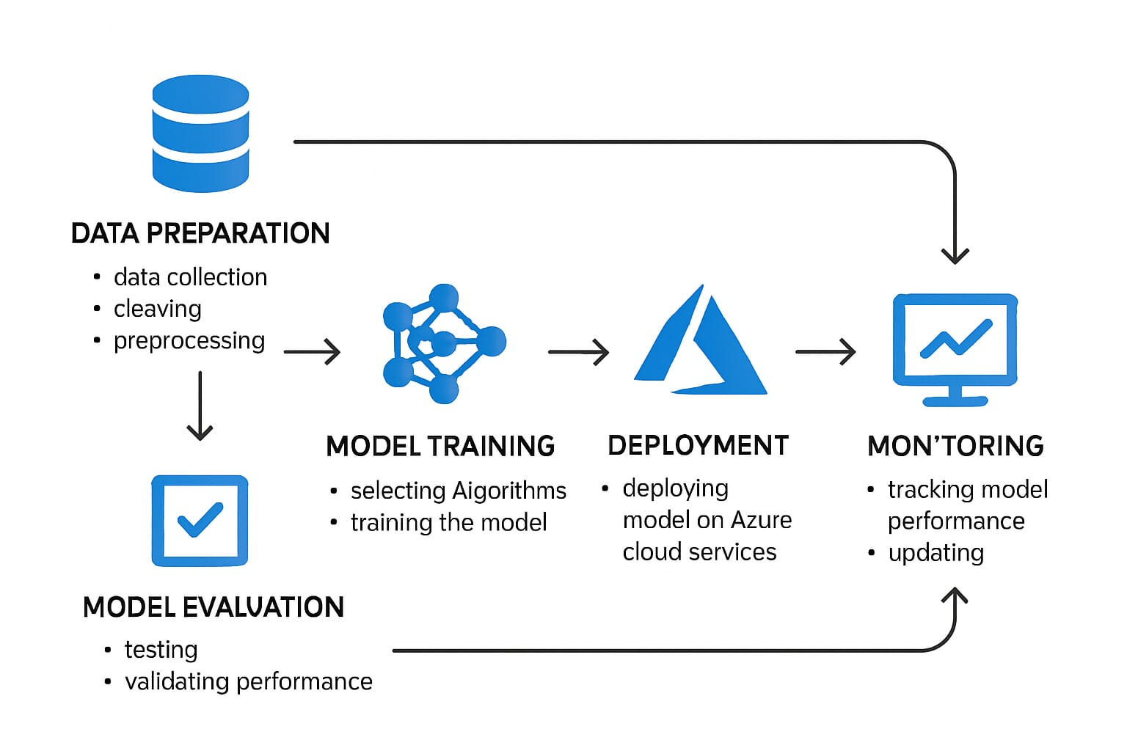
Data flow Diagram

Slide 7
Tools, Technology & Proposed Methodology
Tools & Technology:
Programming Language: Python
Framework: TensorFlow / Keras
Dataset: MNIST (Modified National Institute of Standards and Technology)
Environment: Google Colab / Jupyter Notebook
Libraries: NumPy, Matplotlib, scikit-learn
Proposed Methodology:
Data Preprocessing – Normalize, reshape, and one-hot encode labels.
CNN Architecture – Input layer → Conv2D → MaxPooling → Dense → Output.
Training – Train model on training dataset with multiple epochs.
Evaluation – Evaluate accuracy and loss on the test set.
Prediction – Use the trained model to predict unseen handwritten digits.

Slide 8
Implementation Flow & Planning
Data Loading & Preprocessing
Model Creation (CNN)
Model Compilation & Training
Model Evaluation
Accuracy Analysis & Visualization
Prediction & Testing
Dataset Overview
Name: MNIST Classes: 10 (Digits 0 through 9) Image Size: 28x28 grayscale Train/Test Split: Train (60,000), Test (10,000)

Slide 9
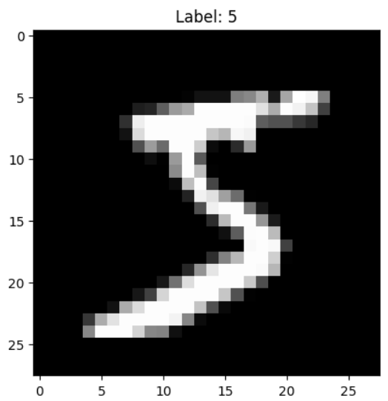
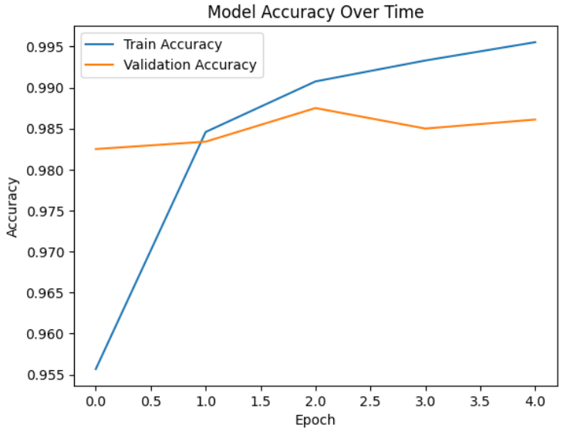
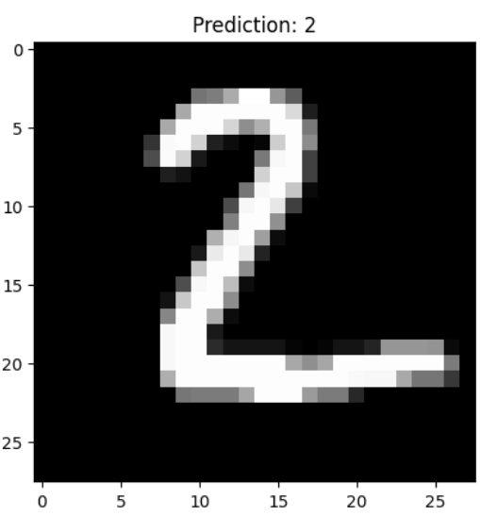
Basic CNN
Model Accuracy
Image
Prediction

Slide 10
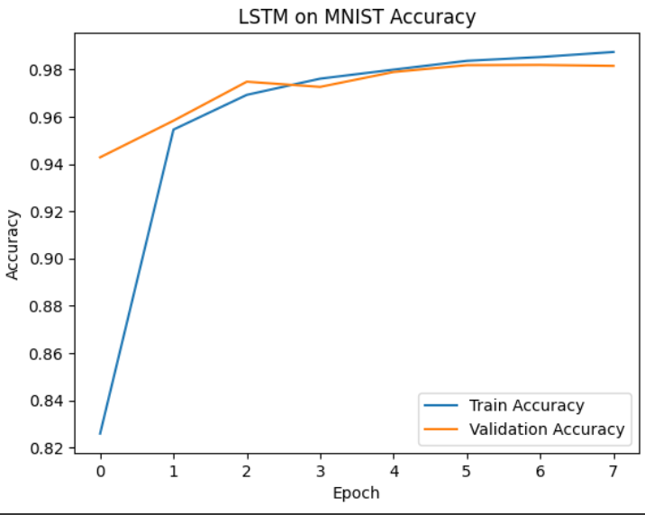
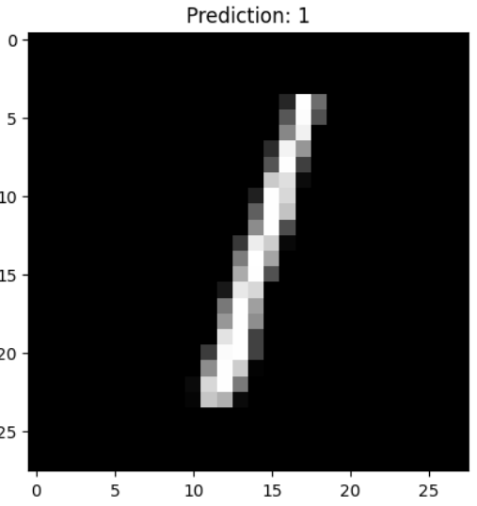
LSTM/RNN
Model Accuracy
Image
Prediction

Slide 11
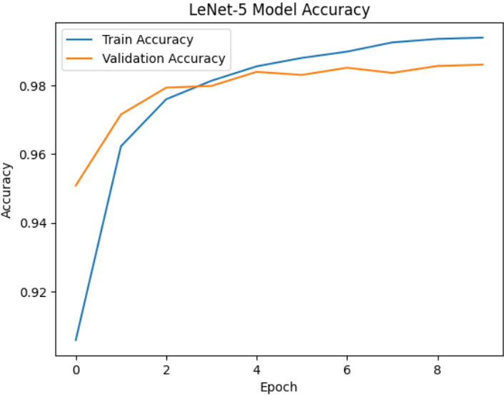
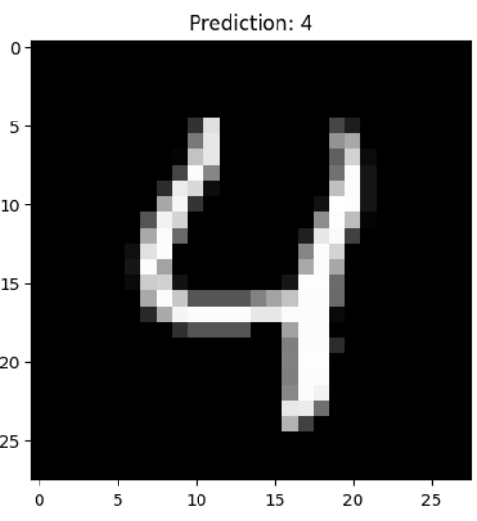
LeNet-5
Model Accuracy
Image
Prediction

Slide 12
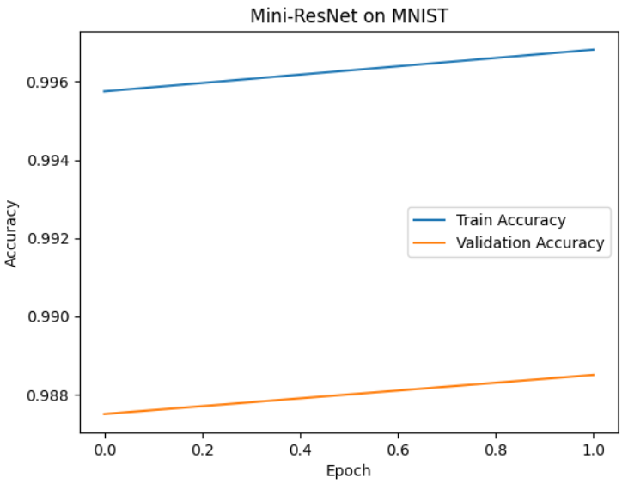
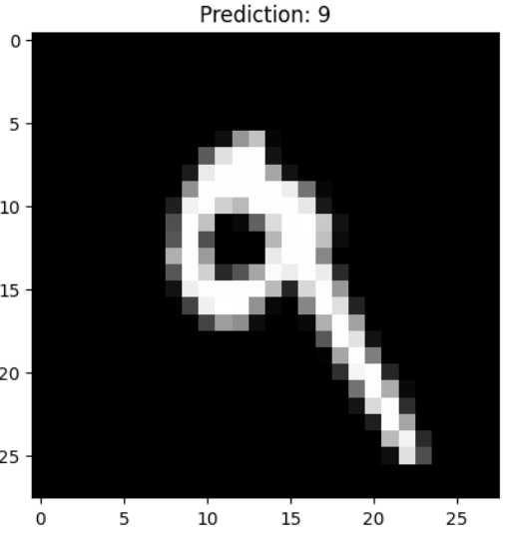
ResNet
Model Accuracy
Image
Prediction

Slide 13
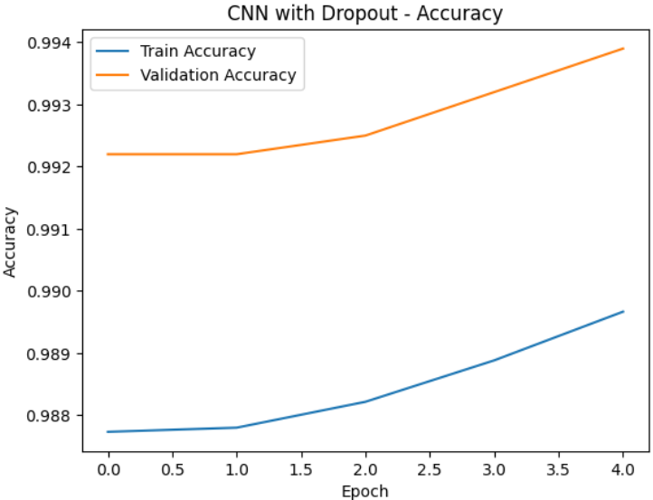
CNN using dropout regularization
Model Accuracy
Image
Prediction

Slide 14
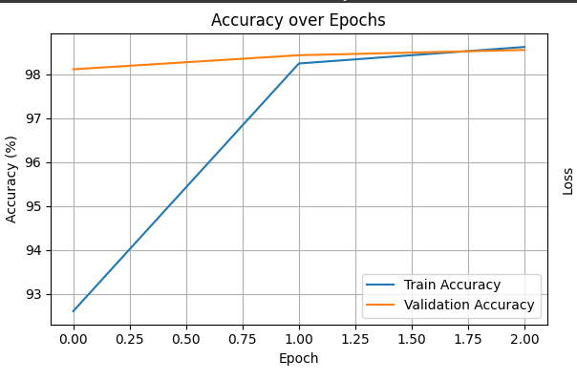
GhostNet 050 Model
Model Accuracy
Image
Prediction

Slide 15
Challenges
Training time for deep models
Overfitting on smaller networks
Model tuning and hyperparameter search
LSTM slower due to sequential processing
Future Work
Try ensemble of CNNs
Experiment with Vision Transformers
Deploy on web using Flask or Streamlit or API

Slide 16
Conclusion
This project explored various CNN and deep learning models for MNIST digit recognition. ResNet and CNN with dropout showed best accuracy and generalization. We conclude that regularization and architectural depth significantly improve model robustness for this task.
References
LeCun et al., 1998 - LeNet-5 paper
MNIST Dataset (http://yann.lecun.com/exdb/mnist/)
He et al., 2015 - ResNet paper
TensorFlow/Keras Documentation
PyTorch Official Tutorials

Slide 17
Q&A

Slide 18


